Slide 1
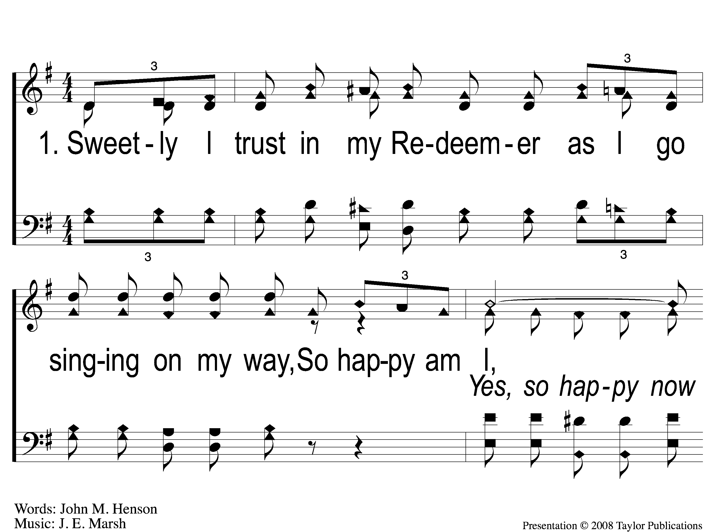
1-1 Happy Am I
Happy Am I
150

Slide 2
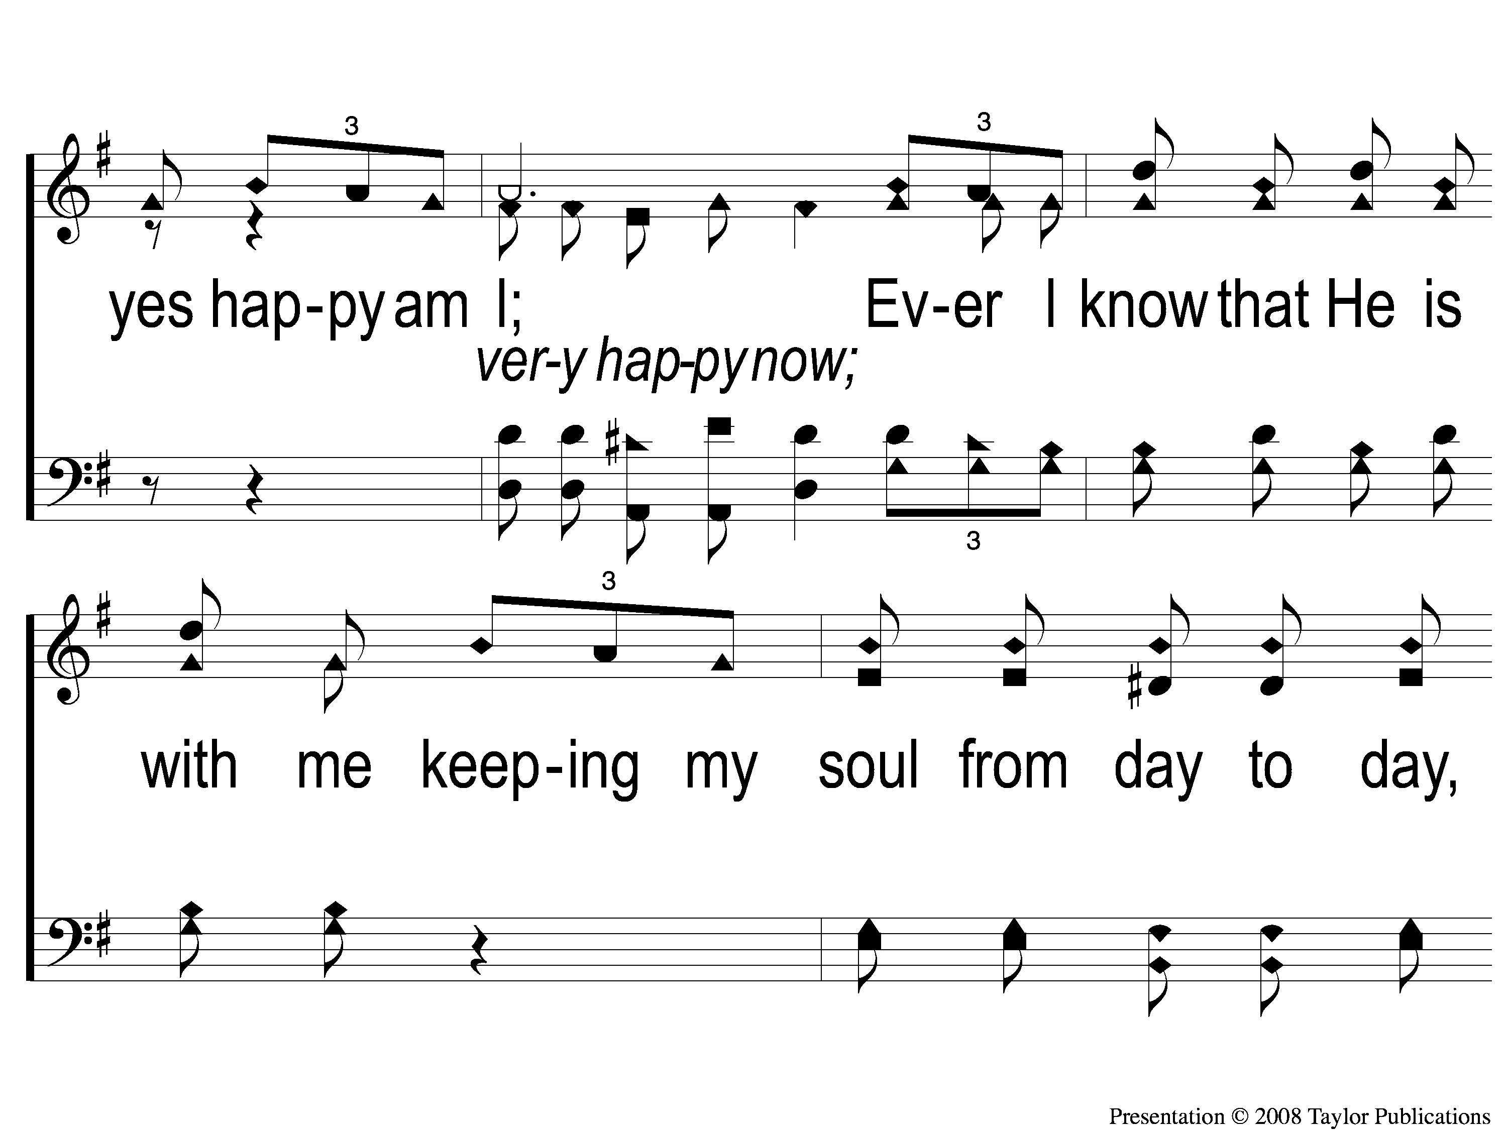
1-2 Happy Am I
Happy Am I
150

Slide 3
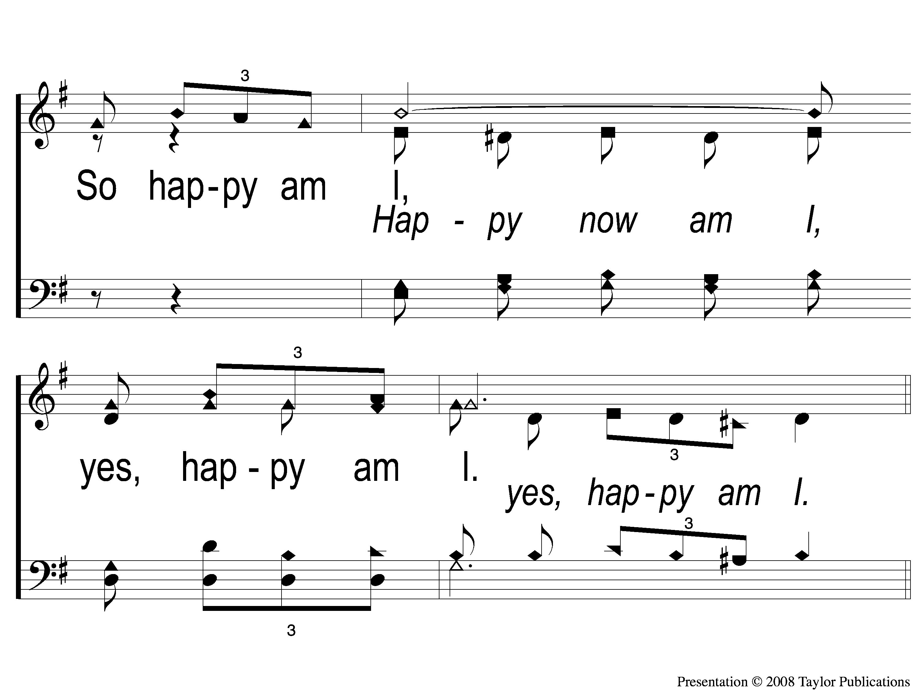
1-3 Happy Am I
Happy Am I
150

Slide 4
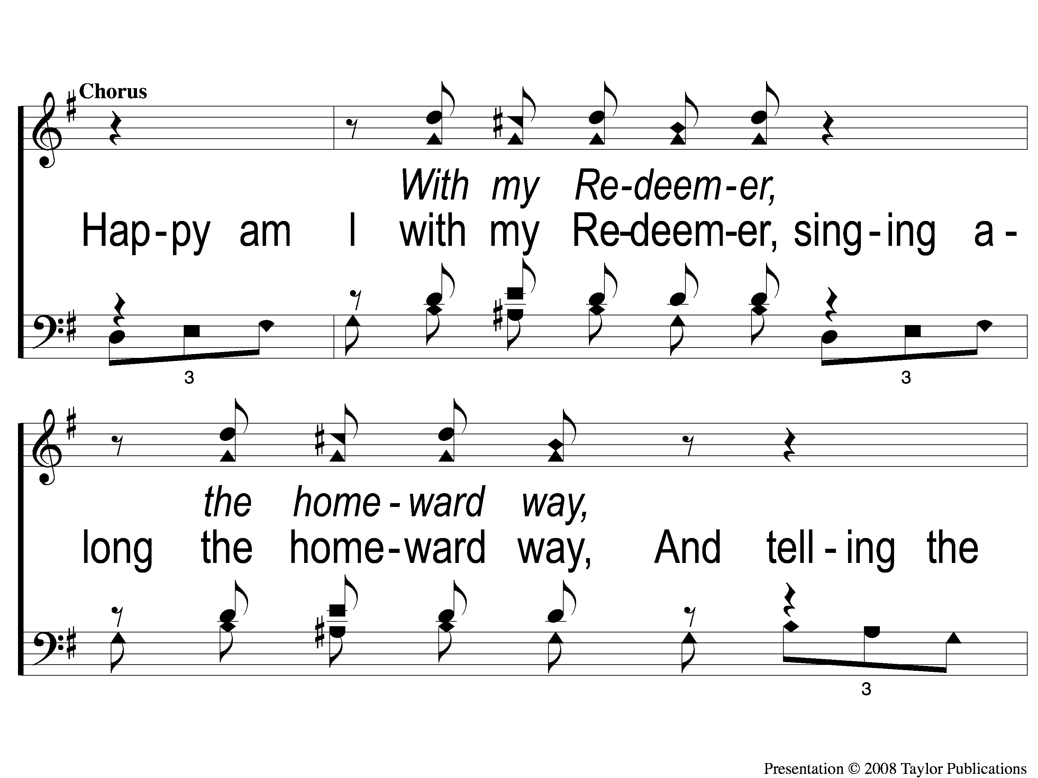
C-1 Happy Am I
Happy Am I
150

Slide 5
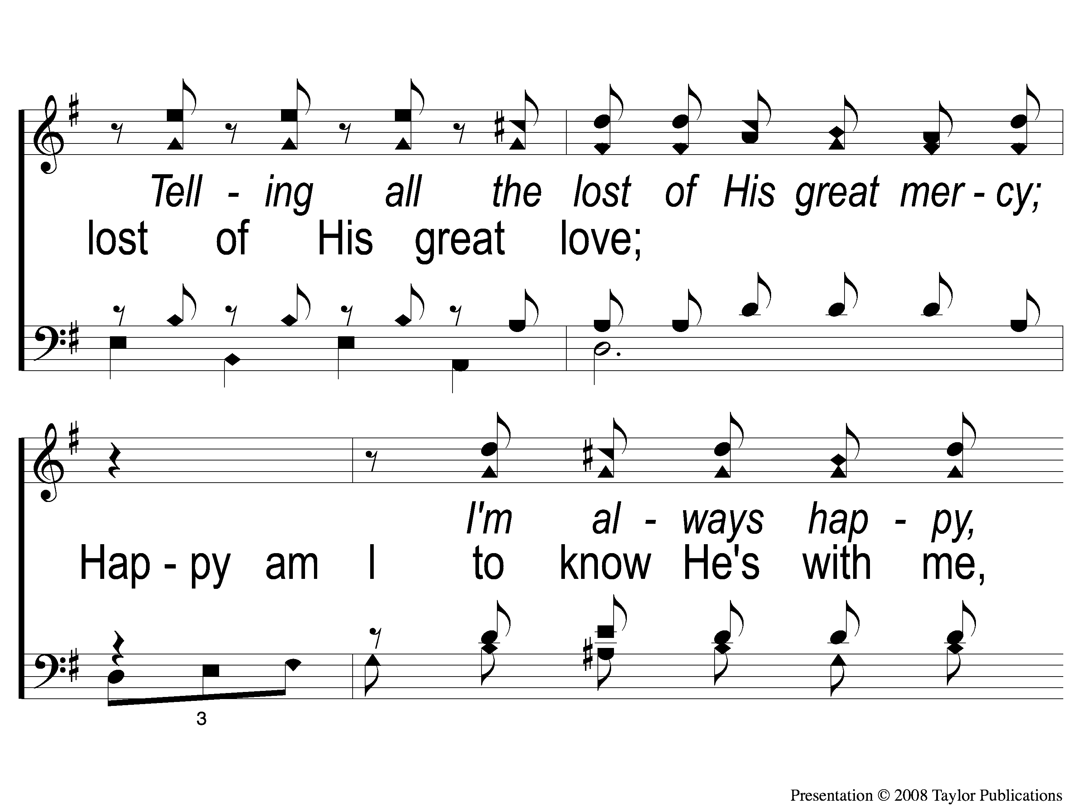
C-2 Happy Am I
Happy Am I
150

Slide 6
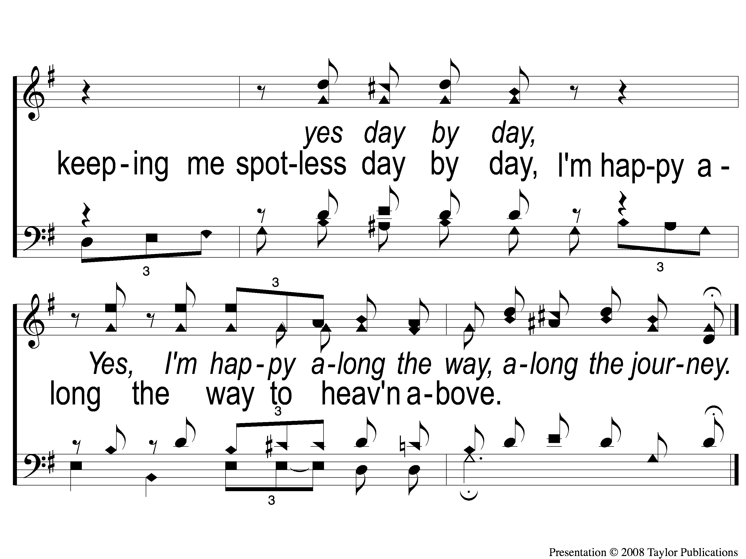
C-3 Happy Am I
Happy Am I
150

Slide 7
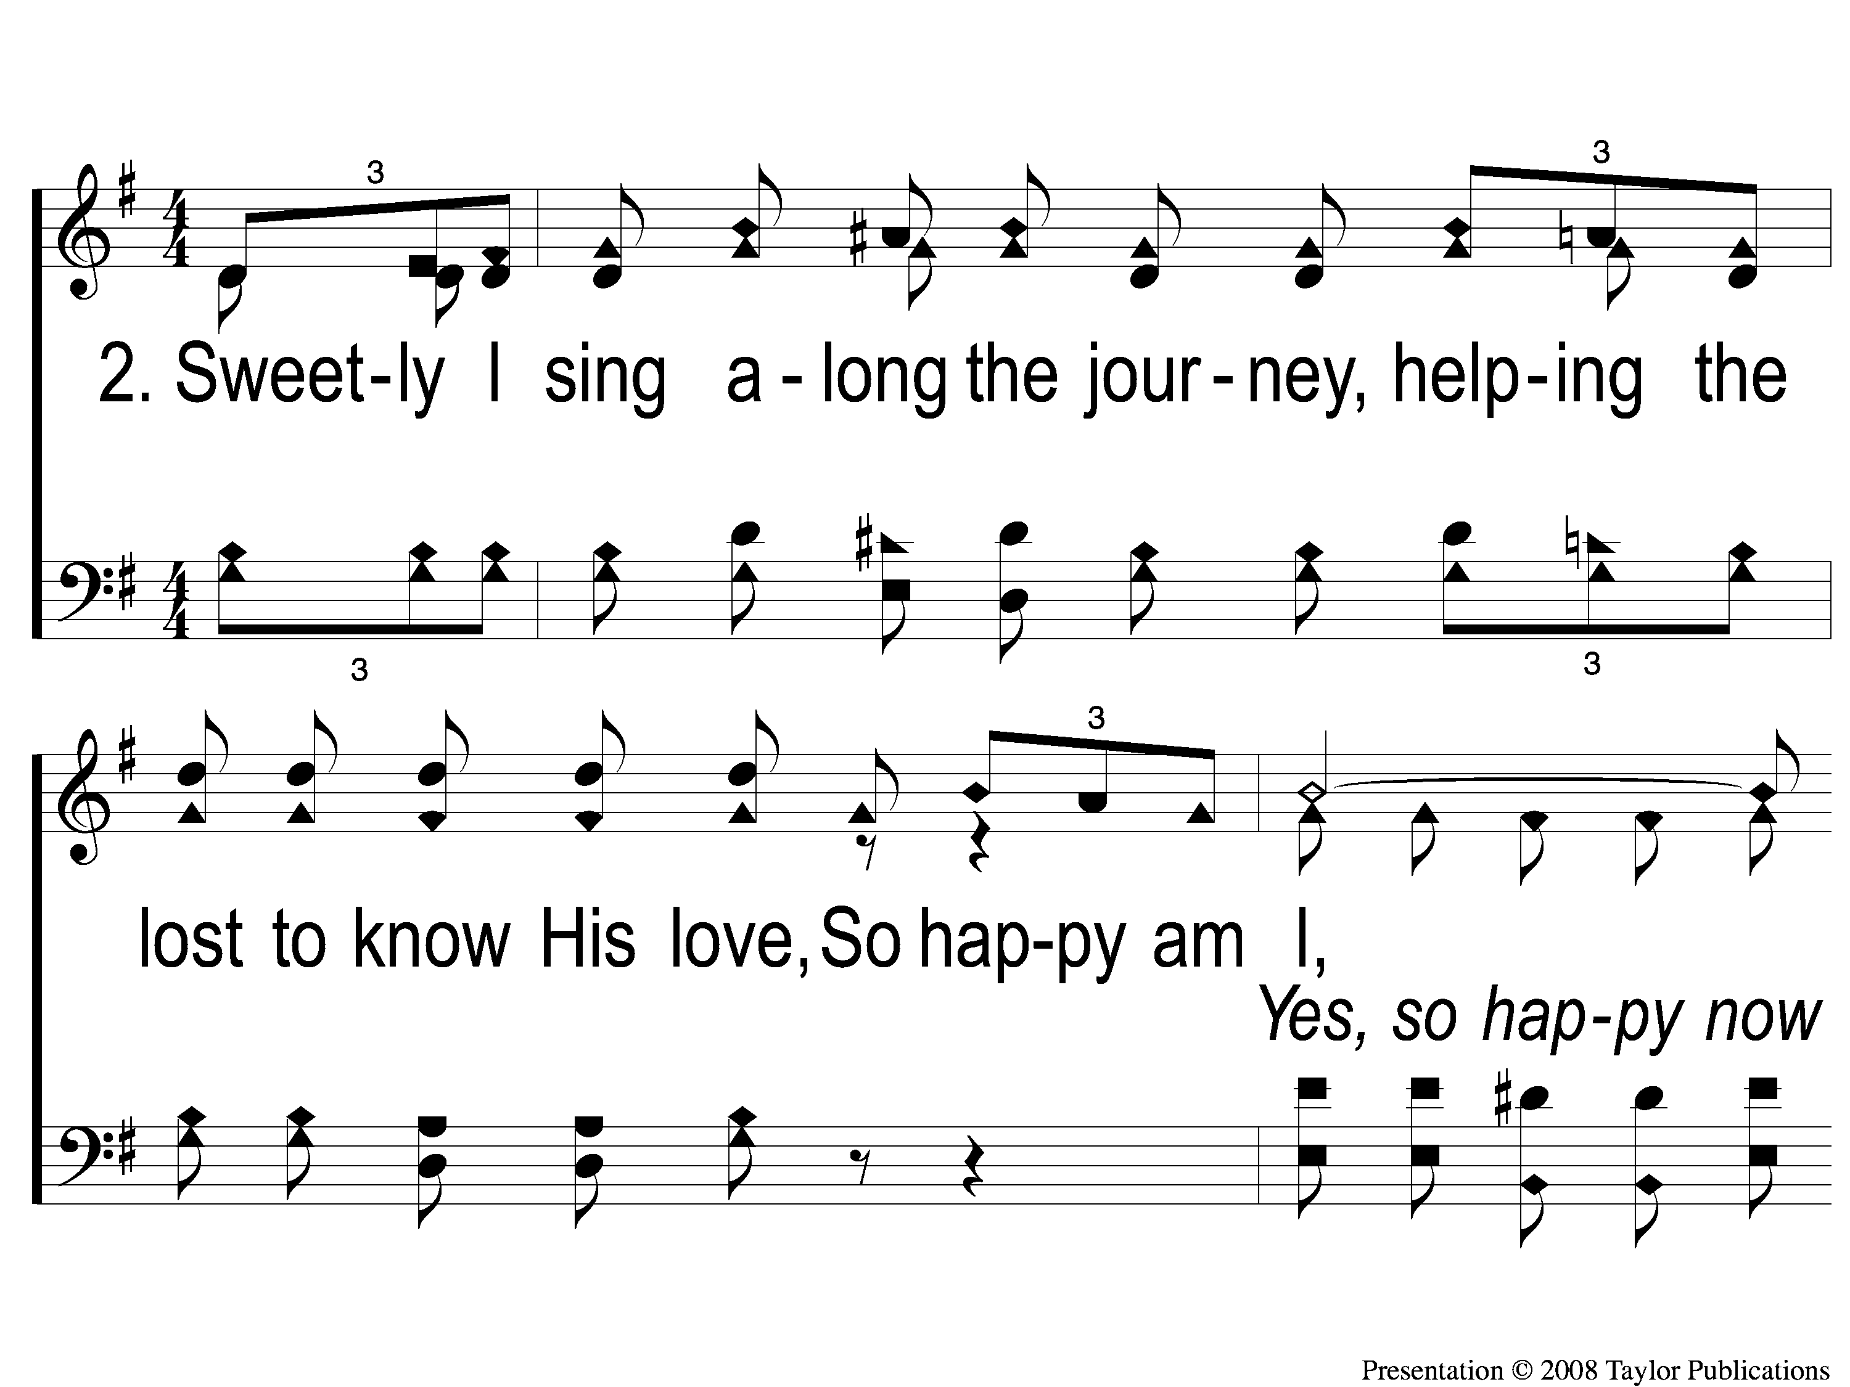
2-1 Happy Am I
Happy Am I
150

Slide 8
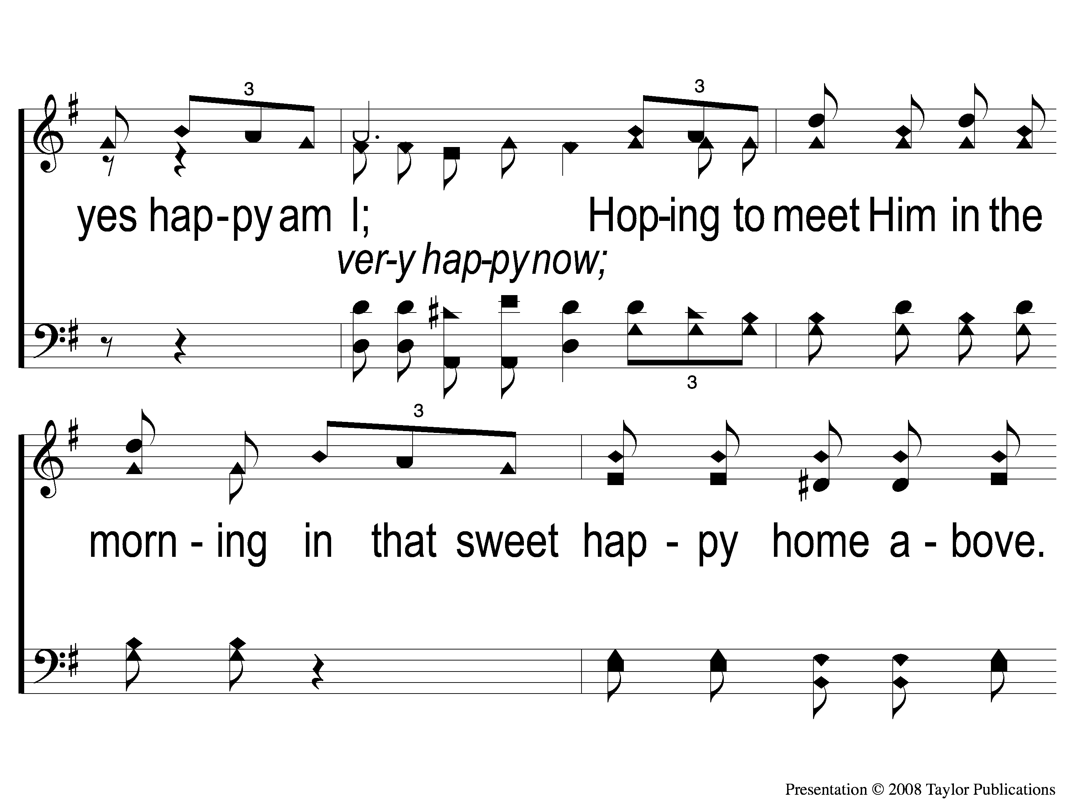
2-2 Happy Am I
Happy Am I
150

Slide 9
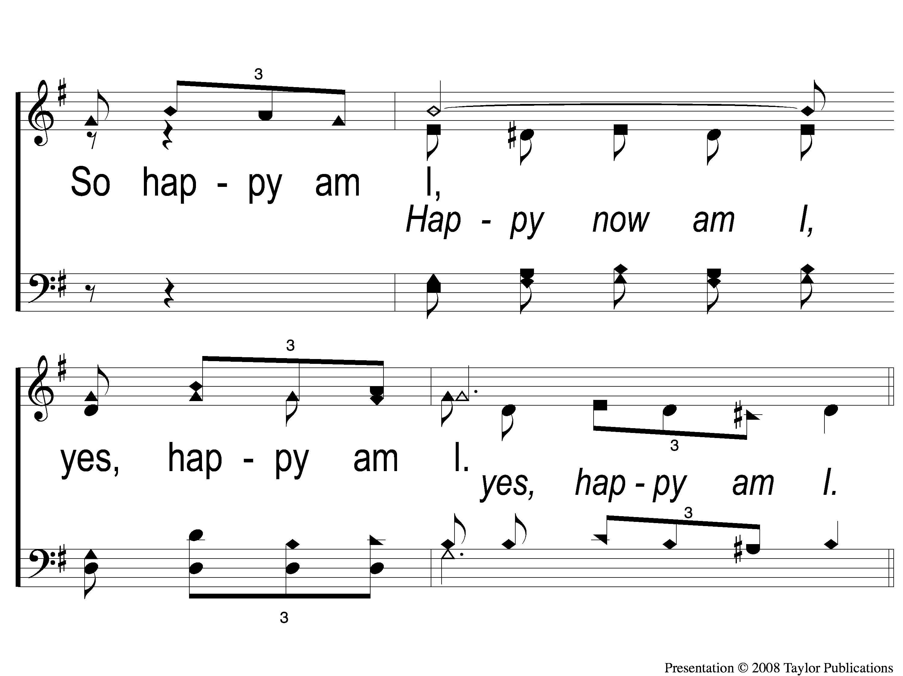
2-3 Happy Am I
Happy Am I
150

Slide 10
C-1 Happy Am I
Happy Am I
150

Slide 11
C-2 Happy Am I
Happy Am I
150

Slide 12
C-3 Happy Am I
Happy Am I
150

Slide 13
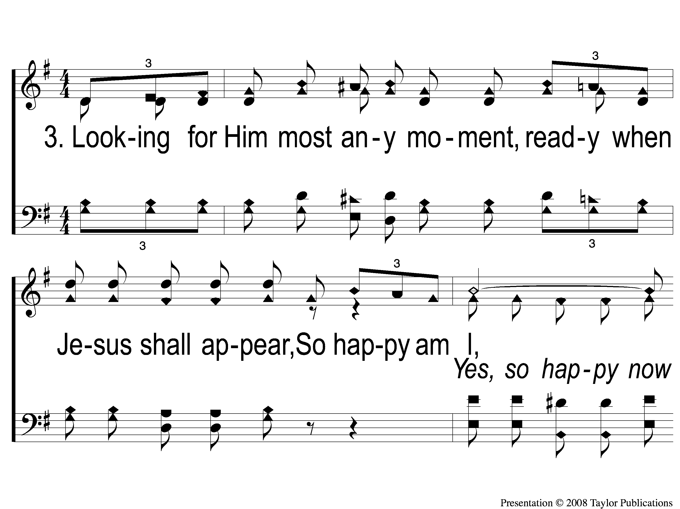
3-1 Happy Am I
Happy Am I
150

Slide 14
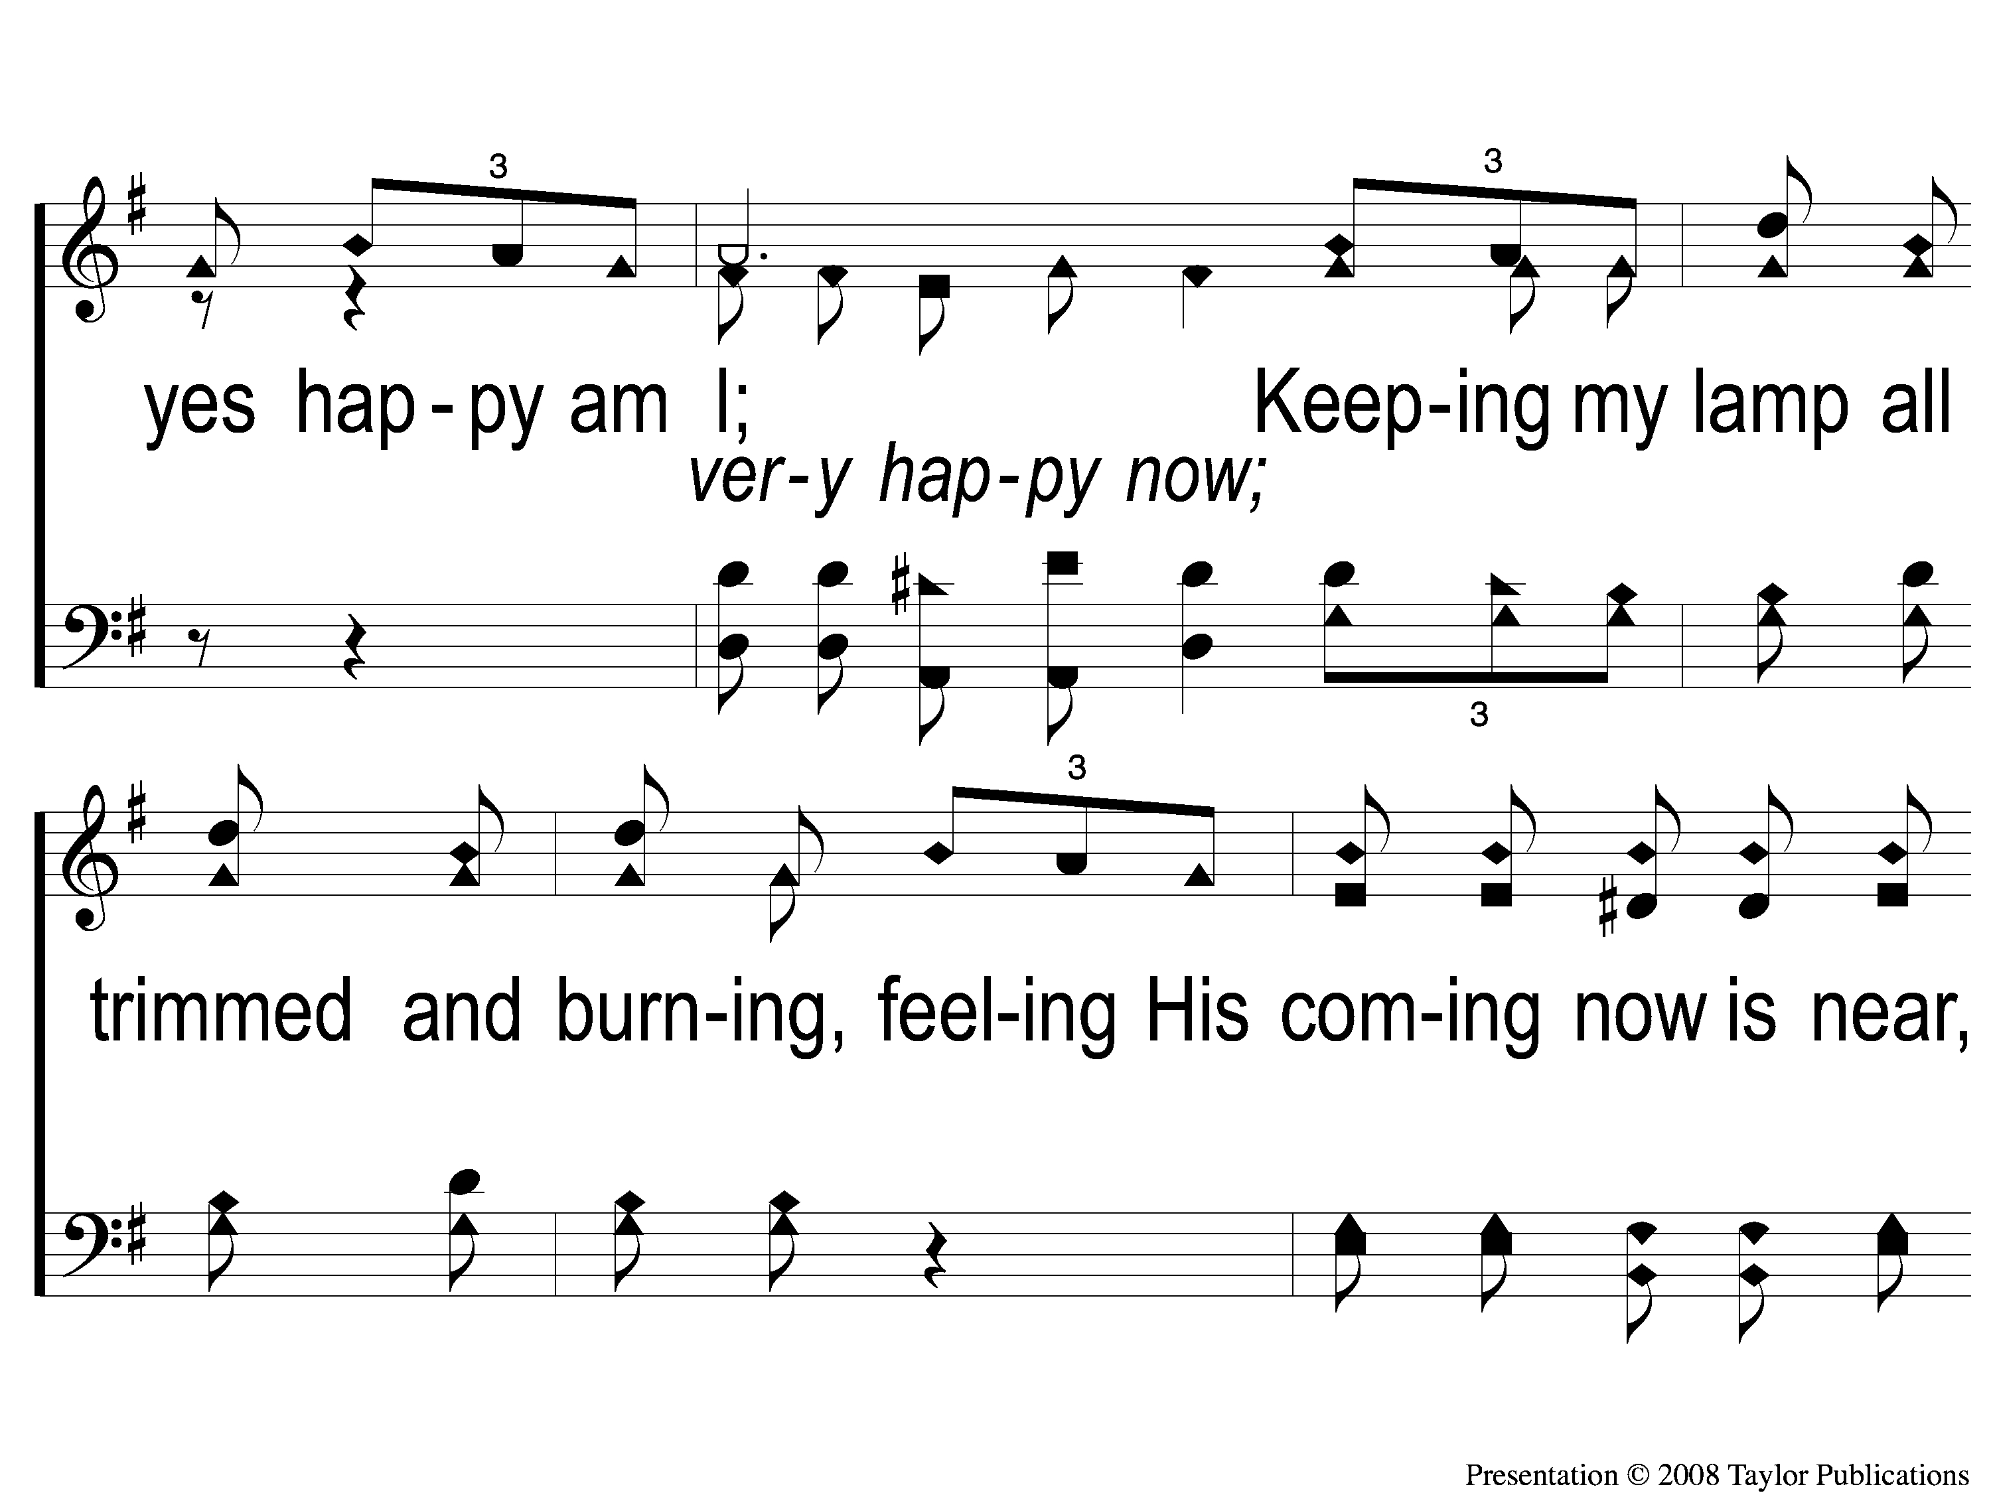
3-2 Happy Am I
Happy Am I
150

Slide 15

3-3 Happy Am I
Happy Am I
150

Slide 16
C-1 Happy Am I
Happy Am I
150

Slide 17
C-2 Happy Am I
Happy Am I
150

Slide 18
C-3 Happy Am I
Happy Am I
150

